Slide 1

BIG DATA
CENTRE OF EXCELLENCE

Slide 2

WHAT IS BIG DATA??

Slide 3
A WALKTHROUGH
‘Big Data’ is similar to ‘small data’, but bigger in size
But having data bigger it requires different approaches:
Techniques, tools and architecture
An aim to solve new problems or old problems in a better way
Big Data generates value from the storage and processing of very large quantities of digital information that cannot be analyzed with traditional computing techniques.

Slide 4
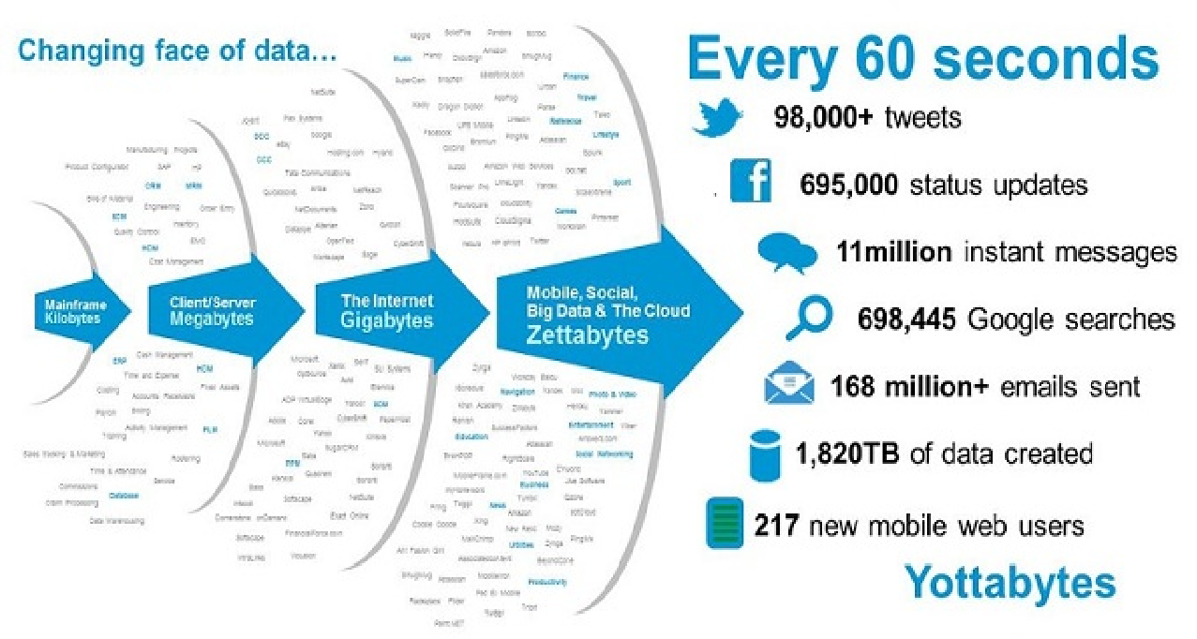

Slide 5
Big Data Centre of Excellence
"Big Data Centre of excellence" is the research and development centre established under Ajay Kumar Garg Engineering College. We are the hub of latest technologies. At BDCOE, we strive to stimulate interest in Big Data concept and related technologies among the students of the institution. Besides making serious endeavors to spread knowledge on Big Data, we stand by the subtle acronym of TEAM - "Together Everyone Achieves More" which has bound the organization and helped it to grow to its present potential. We spear head at technologies like Big Data, Machine learning and Deep learning along with web development and app development.
Our belief system includes hereditary learning and constant improvement. We aim at producing competent individuals and doing outsourced projects.

Slide 6
Domains
Big Data
Designing
Data Science
Machine Learning
Web Development
App Development
Competitive Programming

Slide 7
Projects by us
TEDx App
Saksham App
Scrolls App

Slide 8


Reach Out To Us At
http://www.bdcoe.co.in
https://www.instagram.com/bdcoe/
CSIT Floor 3, BDCoE Lab

Slide 9
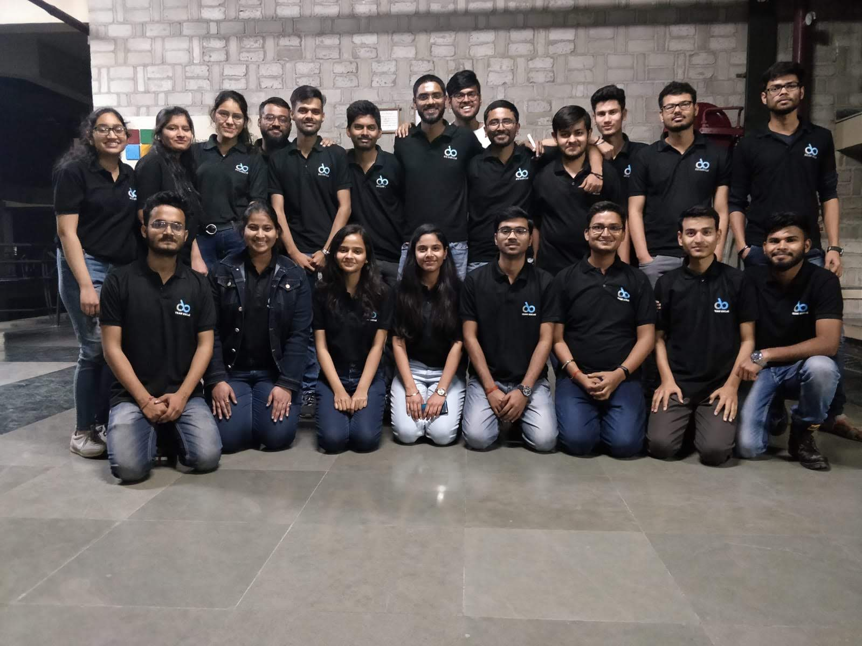
Our Team

Slide 10
VOLUME
Data Volume
44x increase from 2009 2020
From 0.8 zettabytes to 35zb
Data volume is increasing exponentially

Slide 11
2. VELOCITY
Data is begin generated fast and need to be processed fast
Online Data Analytics
Late decisions - missing opportunities
Example:
E-Promotions: Based on your current location, your purchase history, what you like send promotions right now for store next to you

Slide 12
3. VARITY
Various formats, types, and structures
Text, numerical, images, audio, video, sequences, time series, social media data, multi-dim arrays, etc…
Static data vs. streaming data
A single application can be generating/collecting many types of data

Slide 13
4. VERACITY
Data veracity, in general, is how accurate or truthful a data set may be. In the context of big data, however, it takes on a bit more meaning. More specifically, when it comes to the accuracy of big data, it’s not just the quality of the data itself but how trustworthy the data source, type, and processing of it is. Removing things like bias, abnormalities or inconsistencies, duplication, and volatility are just a few aspects that factor into improving the accuracy of big data.

Slide 14
5. VALUE
Value that includes a large volume and variety of data that is easy to access and delivers quality analytics that enables informed decisions.

Slide 15
Types of Big Data
Structured
Unstructured
Semi-structured

Slide 16
STORING BIG DATA
Analyzing your data characteristics
Selecting data sources for analysis
Eliminating redundant data
Establishing the role of NoSQL
Overview of Big Data stores
Data models: key value, graph, document, column-family
Hadoop Distributed File System
HBase
Hive

Slide 17
PROCESSING BIG DATA
Integrating disparate data stores
Mapping data to the programming framework
Connecting and extracting data from storage
Transforming data for processing
Subdividing data in preparation for Hadoop MapReduce
Employing Hadoop MapReduce
Creating the components of Hadoop MapReduce jobs
Distributing data processing across server farms
Executing Hadoop MapReduce jobs
Monitoring the progress of job flows

Slide 18
Growth of Big Data is needed
Increase of storage capacities
Increase of processing power
Availability of data(different data types)
Every day we create 2.5 quintillion bytes of data; 90% of the data in the world today has been created in the last two years alone

Slide 19
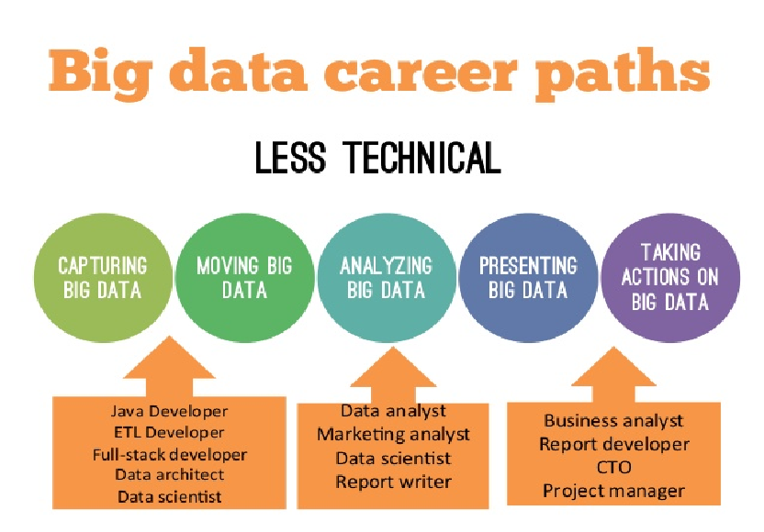

Slide 20
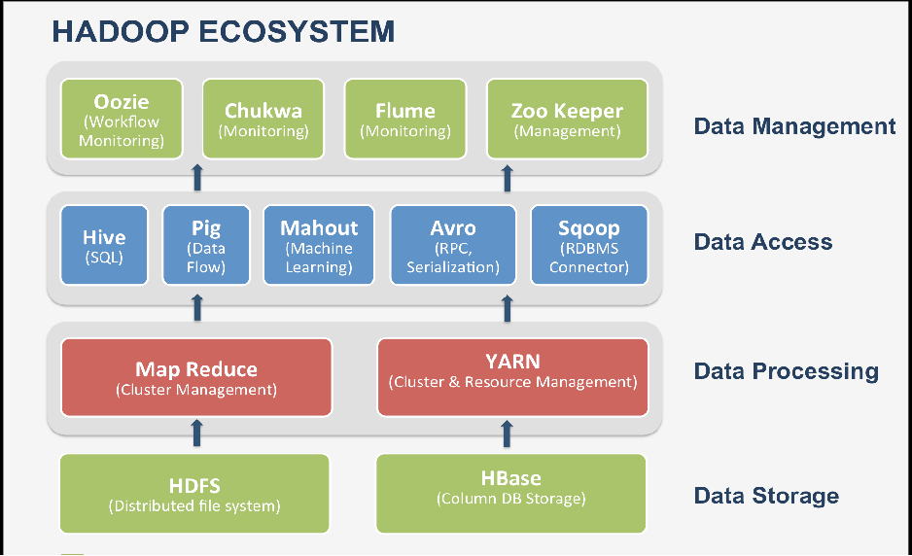
Big Data Tools

Slide 21
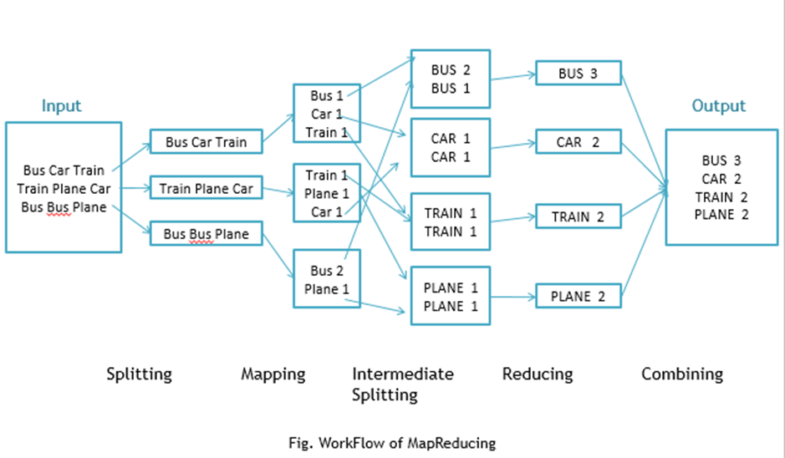
MapReduce Functionality

Slide 22
Other Big Data Tools
Python
R
Mongo DB
Storm
Cloudera
Kaggle
Tableau

Slide 23
FUTURE OF BIG DATA
$15 billion on software firms only specializing in data management and analytics.
This industry on its own is worth more than $100 billion and growing at almost 10% a year which is roughly twice as fast as the software business as a whole.
In February 2012, the open source analyst firm Wikibon released the first market forecast for Big Data , listing $5.1B revenue in 2012 with growth to $53.4B in 2017
The McKinsey Global Institute estimates that data volume is growing 40% per year, and will grow 44x between 2009 and 2020.

Slide 24
Thank YOU!!

